Slide 1
Pore pressure estimation and mud weight prediction on seismic and well data
Zayrullin I.I.

Slide 2
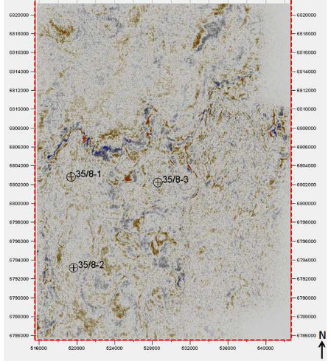
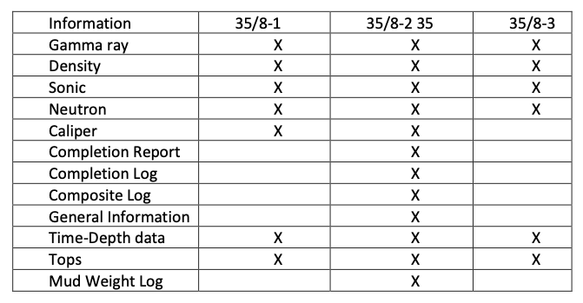
Dataset Description
Set of three well logs
Seismic data cube
Information on well tops (geological formations or significant intervals)
Well reports
Description of the well’s dataset
Plan view of a slice from the seismic cube showing the location of the wells

Slide 3


Tasks
Reconstruct* a mud weight profile for wells 35/8-1 and 35/8-3 using seismic data.
Compute* a pore pressure profile for wells 35/8-1, 35/8-2, 35/8-3 based on the analysis of seismic data and well logging.
Calculate* a volume of the recommended drilling mud weight and pore pressure prediction fields within the 3D seismic counter.

Slide 4
Workflow
Data Quality Control
Fill NaNs
Distribution analysis
OP markers
Time-to-depth transformation
Calculation depth curve from dt
Add coordinates data to geometry dictionary
Seismic data to Mud Weight
Amplitude to Impedance (deconvolution)
Porosity Pressure estimation

Slide 5
Well data (logs)

Slide 6
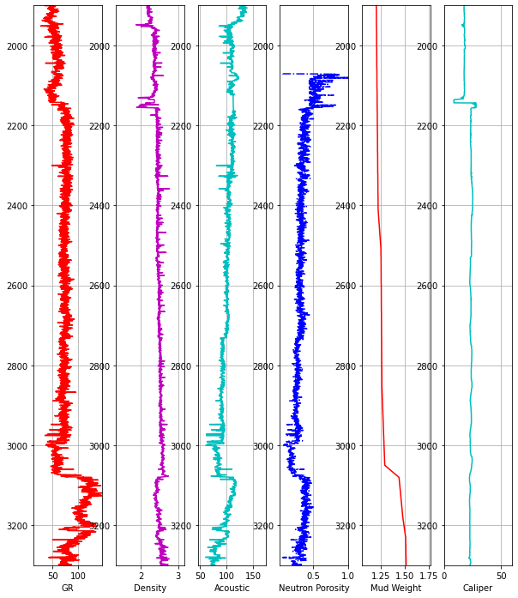
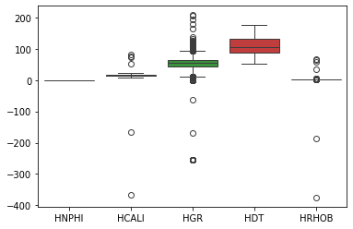
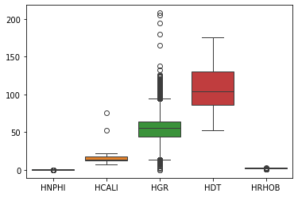
First look
Well # 35/8-2
Data processing:
Outliers to NaN
Interpolation

Slide 7
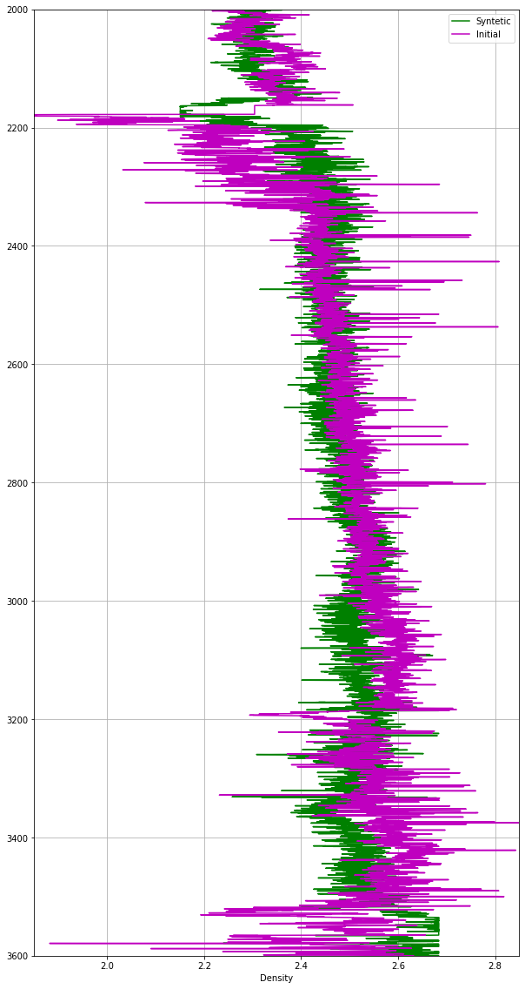

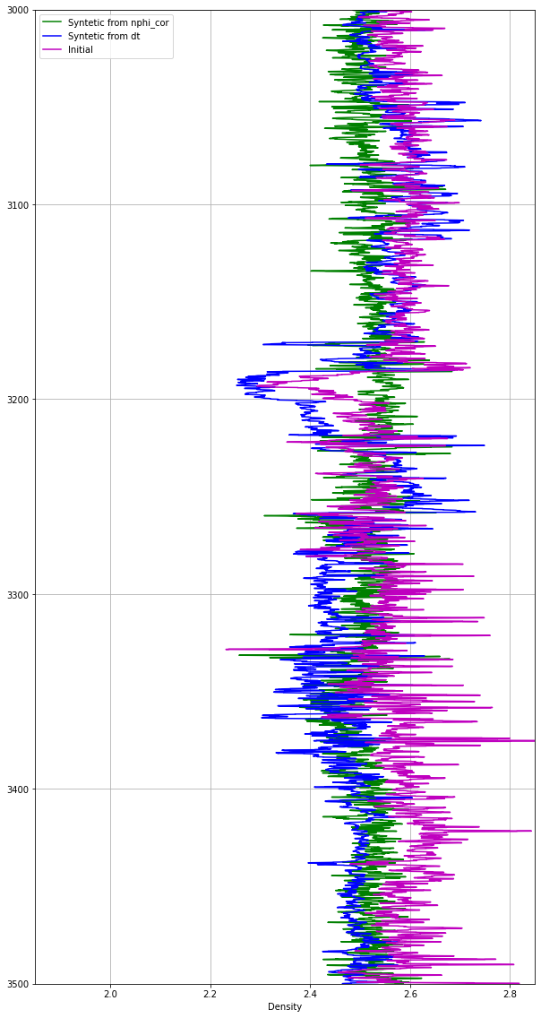
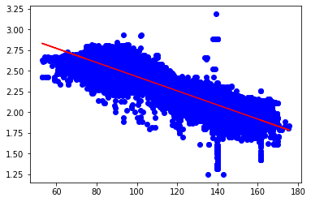
Well # 35/8-2
Well # 35/8-2
RHOB, g/cm3
DT, mks/m
Curve reconstruction methods :
dGR -> Kp -> RHOB_corrected
RHOB from DT (equation above)
Another equation (Kp from DT)
RHOB

Slide 8
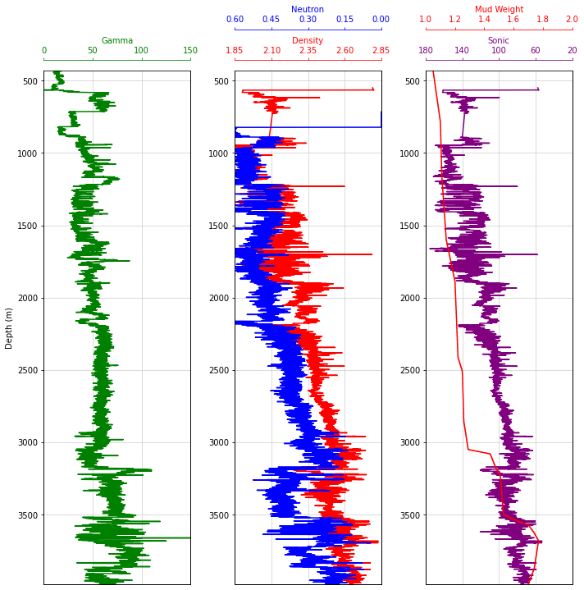
Overpressure features
Well # 35/8-2
Clay layer under the OP interval*
* Zoeller, W. A. "Pore Pressure Detection From the MWD Gamma Ray" (1983)

Slide 9
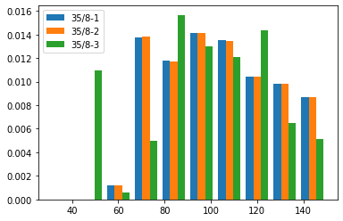
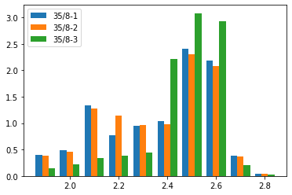
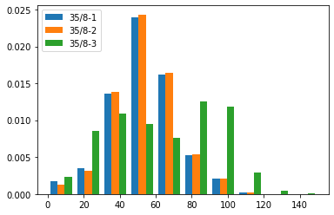
DT
RHOB
GR
Data distribution in 8-1 and 8-2 is similar
*Seems 8-2 also has OP layer

Slide 10
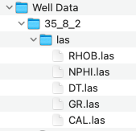
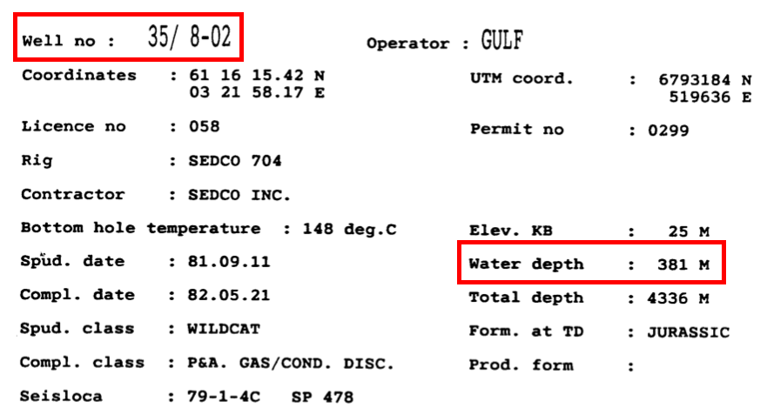
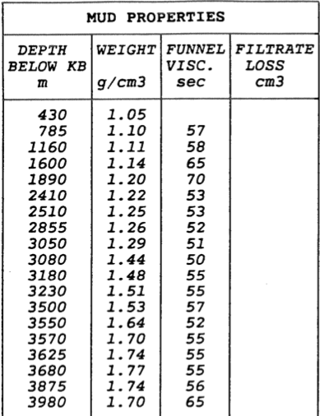
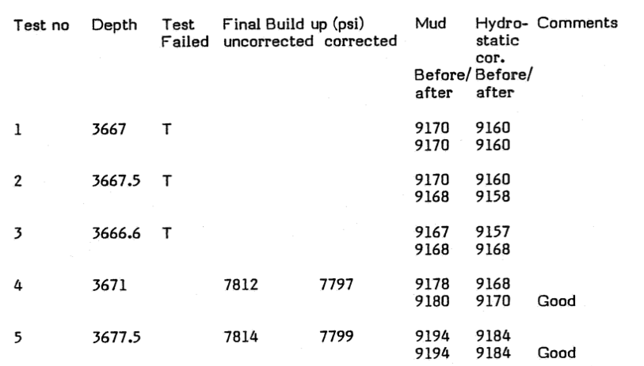
Reference well
Markers
2089 | KYRRE FM
2947 | TRYGGVASON FM
3059 | BLODØKS FM
3060 | CROMER KNOLL GP
3060 | RØDBY FM
3074 | ÅSGARD FM
3079 | VIKING GP
3079 | DRAUPNE FM
3204 | HEATHER FM
3666 | BRENT GP
3666 | TARBERT FM
3717 | NESS FM
3786 | ETIVE FM
3814 | RANNOCH FM
3868 | BROOM FM
3885 | DUNLIN GP
3885 | DRAKE FM
3932 | COOK FM
4064 | BURTON FM

Slide 11
Seismic data

Slide 12
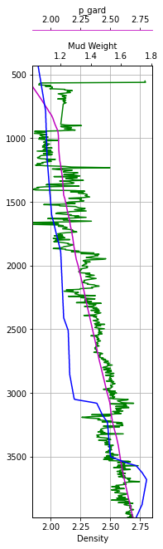
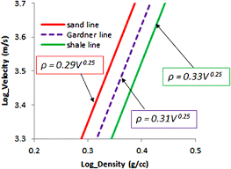
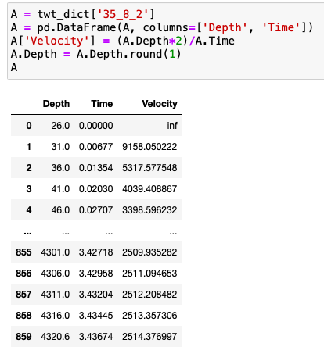
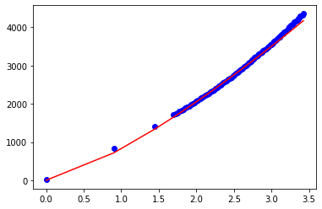
Time to depth law
Well # 35/8-2
Depth, m
Depth, m
Density from Gardner equation
T, sec

Slide 13
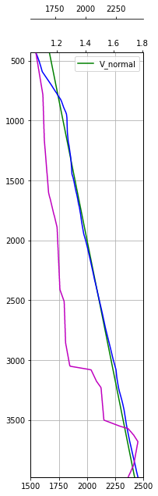
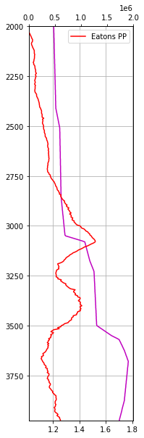
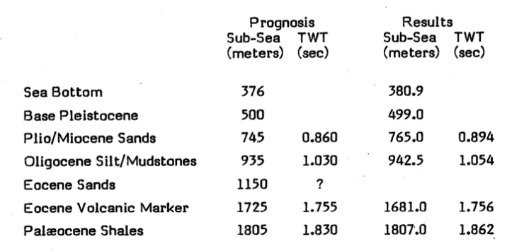

TWT
Well # 35/8-2
Depth, m
las
Calculate Normal Velocity Trend to see difference between normal and registered velocity and to estimate Eaton’s Pore Pressure (right track).
Mud weight curve reacts with short delay as a response for PP increasing.
Eaton’s PP = OBG - (OBG - Phyd) * (NVT / V) ^ Exp
Phyd = Hydrostatic Pore Pressure Gradient
OBG = Overburden Gradient

Slide 14
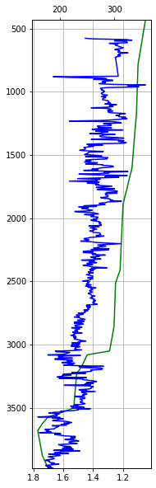
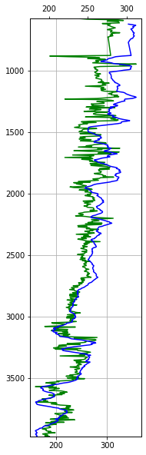
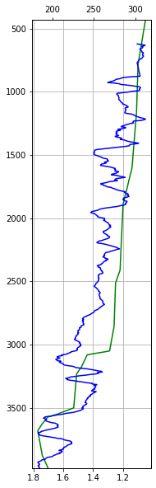

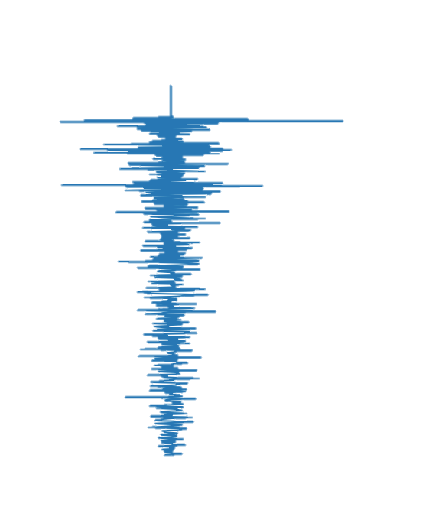
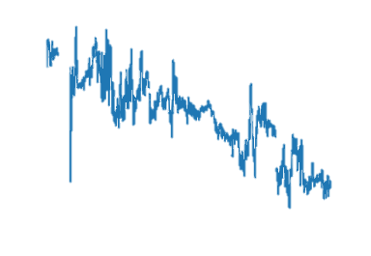
PseudoImpedance
Well # 35/8-2
Calculate PsImp
Smoothed PsImp
Amplitude to PsImp model (fail)
Depth, m
Amplitude
PseudoImpedance

Slide 15
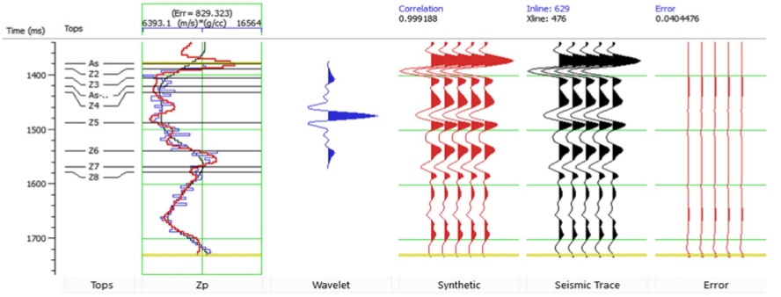
Well log Impedance * Wavelet = Synthetic trace (compare with the recorded trace)

Slide 16
Main Task
Compute a pore pressure profile for wells 35/8-1, 35/8-2, 35/8-3 based on the analysis of seismic data and well logging.

Slide 17
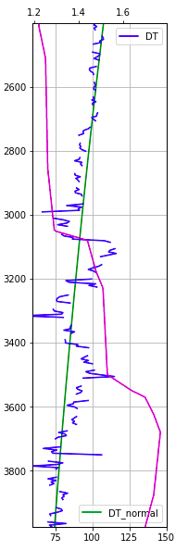
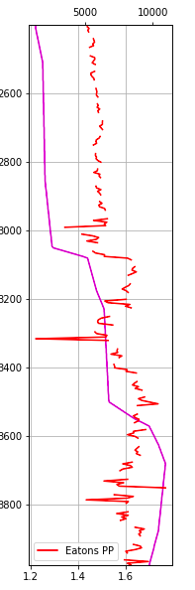
Well # 35/8-2
Logs processing
Velocity from seismic time to depth law
Gardner Density (RHOB*Velocity)
Hydrostatic pressure (Phyd)
Overburden Pressure (OBG)
DT normal gradient (NCT)
Pore pressure estimation through Eaton’s equation
Mud weight from PP
Depth, m
Pore Pressure (PP) = OBG - (OBG - Phyd) * (NCT/ DT)
35/8-2 | Mud Weight | MW_smoothed
MAE | 0.354 | 0.347
MSE | 0.167 | 0.162

Slide 18
Conclusions
Pore pressure profile for wells 35/8-1, 35/8-2, 35/8-3 was computed based on the Eaton’s approach. Metrics for reference well: MSE = 0.162 and MAE = 0.347
Mud weight profile was reconstructed for wells 35/8-1 and 35/8-3 using seismic predicted pore pressure curve.
For the 3rd task got some insights:
Cut 3D seismic cube to work with overpressure interval and detect the same patterns on other parts of cube
Cut seismic traces and use wavelet analyses to reconstruct velocity/impedance and compute the pore pressure through Eaton’s (or the other*) equations on derived interval
More detailed deconvolution (using DT well log to tie with reflection coefficients)
Use slices and CV to detect OP zones
*note below

Slide 19
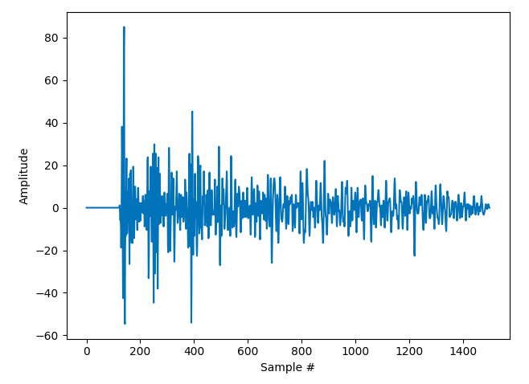
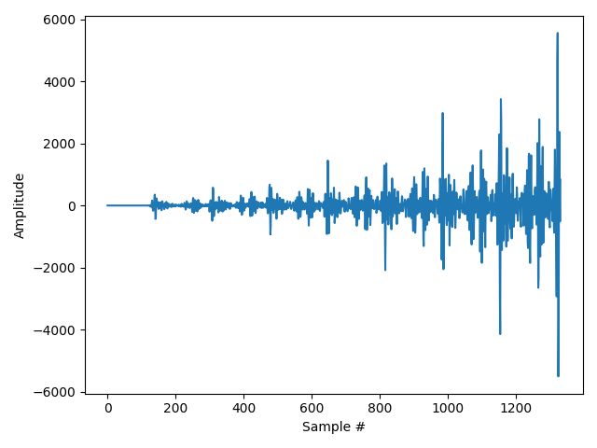

3rd task
a) Trace deconvolution
b) Synthesize traces
c) Detailed analysis seismic cube
The main point is computing Impedance using trace deconvolution and apply new curve in Eaton’s equation
a)
Deconvolution

Slide 20
3rd task
b)
a) Trace deconvolution
b) Synthesize traces
c) Detailed analysis seismic cube
The same as previous approach but in the opposite direction.
From dt in well with overpressure reconstruct trace and find similar in other parts of cube.

Slide 21
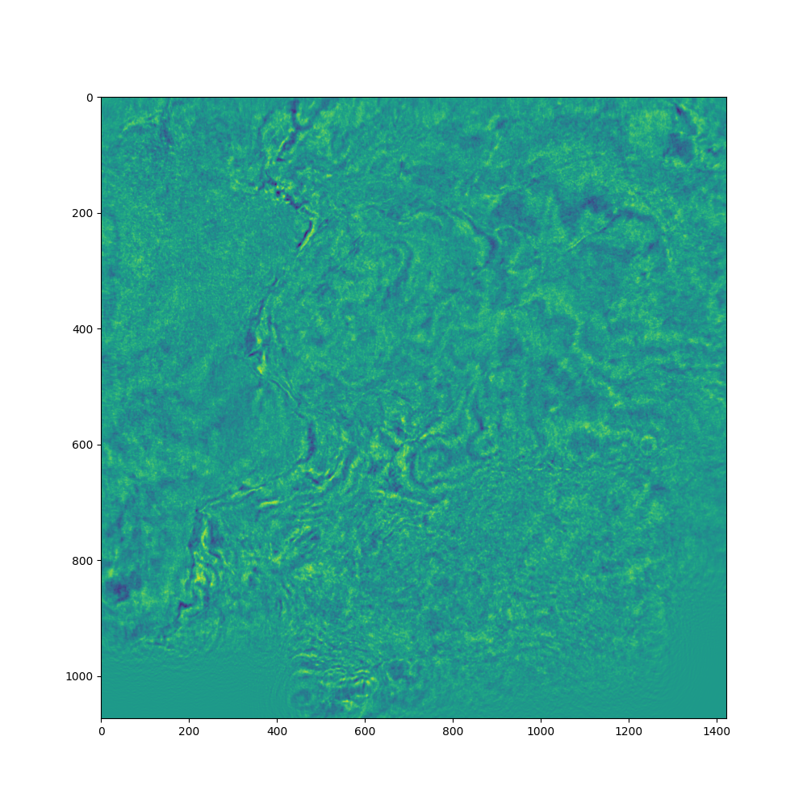
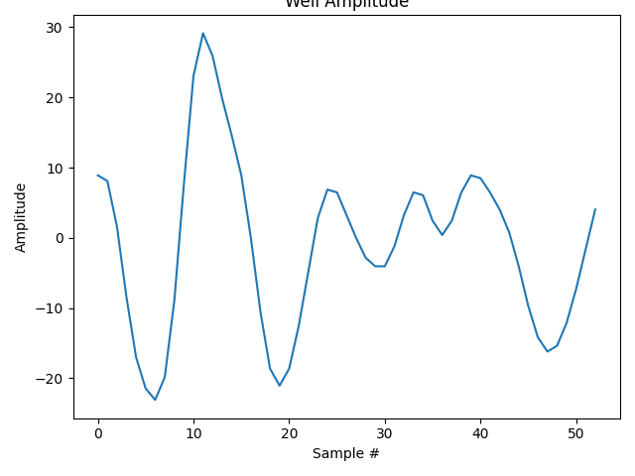
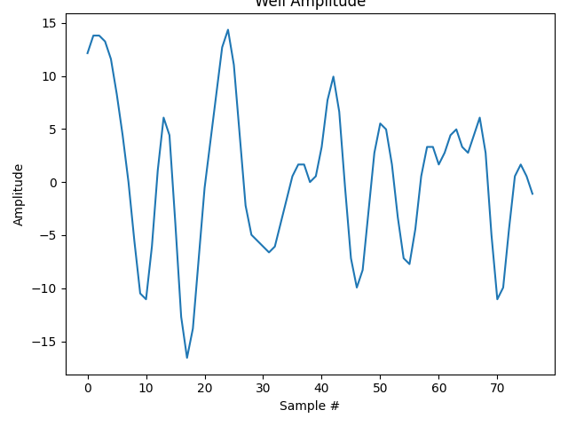
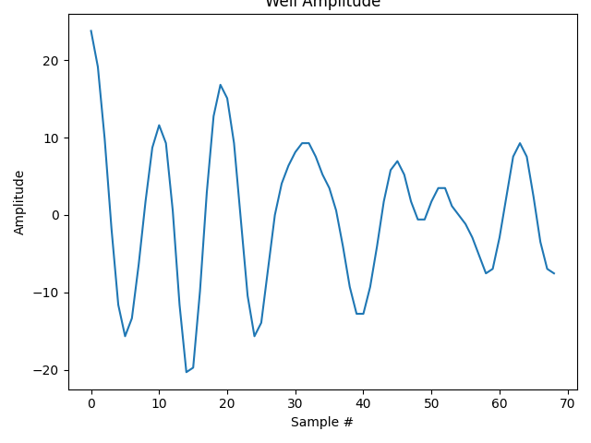
3rd task
Applying previous approaches but on small parts of cube (cut necessary formation)
Using CV on slices to detect overpressure patterns
Traces classification
a) Trace deconvolution
b) Synthesize traces
c) Detailed seismic cube analysis
c)

Slide 22
Well # 35/8-2
OP
Well # 35/8-1
Well # 35/8-3

Slide 24
References
Zhang, Jon. (2011). Pore pressure prediction from well logs: Methods, modifications, and new approaches. Earth-science Reviews - EARTH-SCI REV. 108. 50-63. 10.1016/j.earscirev.2011.06.001.
Riahi, M.A., Fakhari, M.G. Pore pressure prediction using seismic acoustic impedance in an overpressure carbonate reservoir. J Petrol Explor Prod Technol 12, 3311–3323 (2022). https://doi.org/10.1007/s13202-022-01524-y

Slide 25
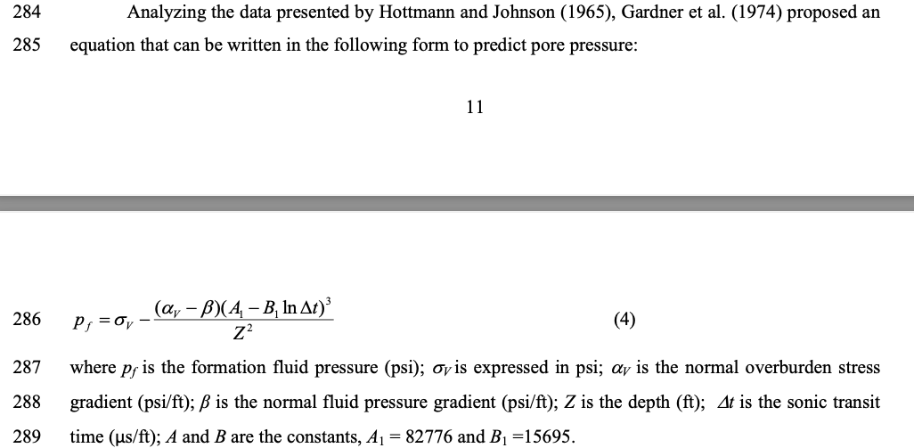
Gardner

Slide 26
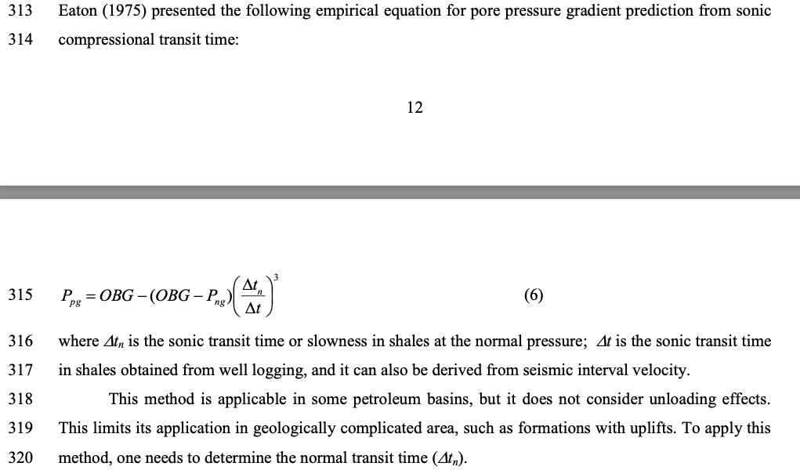
Eaton’s method

Slide 27
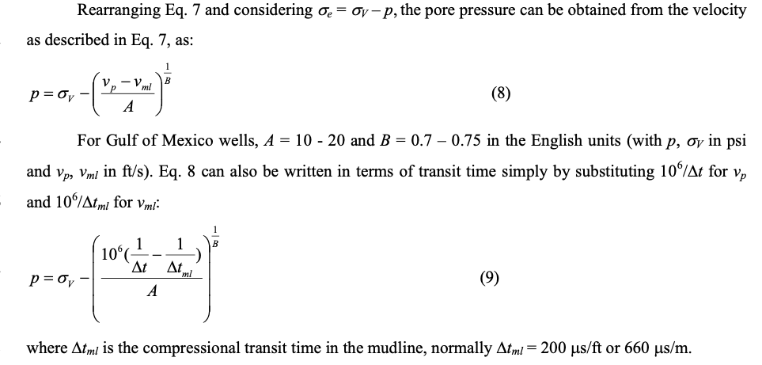
Bower’s method

Slide 28
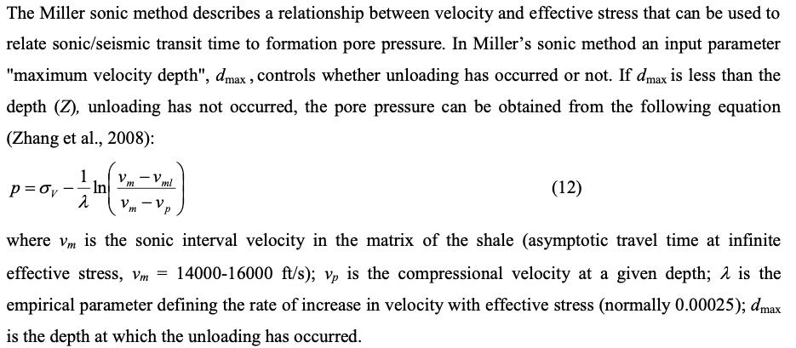
Miller’s method

Slide 29
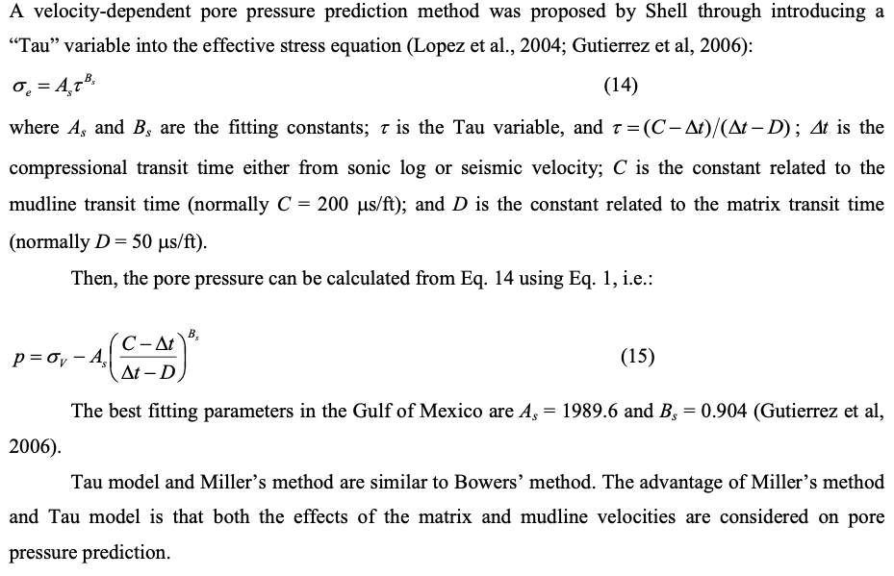
Tau model

